Slide 1
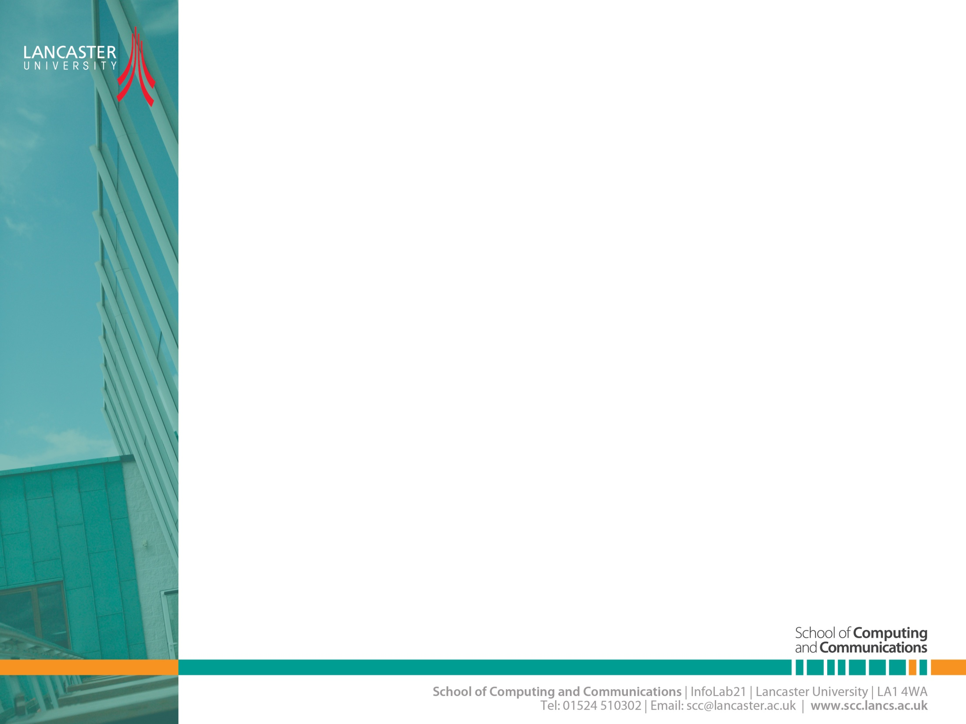
introduction
CNSCC.405
Digital Signal Processing
Dr. Muhammad Abrar (Dr. MAB)
m.abrar@lancaster.ac.uk
CNSCC.405: Digital Signal Processing

Slide 2
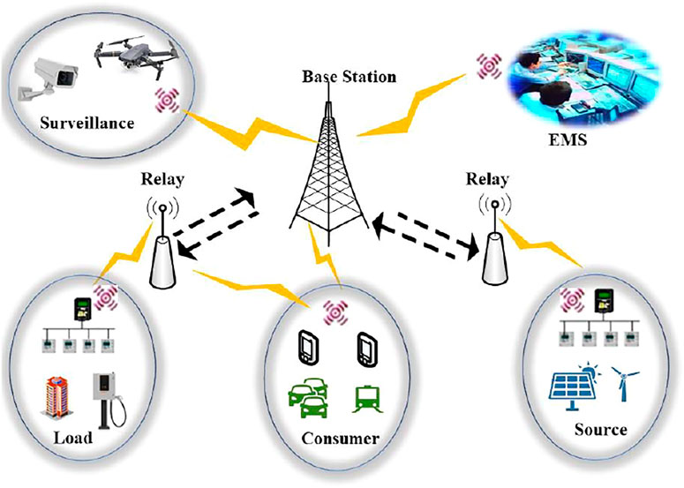
Wireless Communication
Transmitting voice and data using electromagnetic waves in open space (atmosphere)
Fig: https://www.frontiersin.org/articles/10.3389/fenrg.2022.889355/full
CNSCC.405: Digital Signal Processing

Slide 3
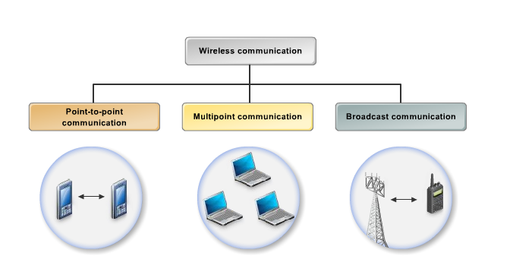
Types of Wireless Communication
celullar
wireless computer network
radio service
CNSCC.405: Digital Signal Processing

Slide 4
Why Wireless?
Freedom from wires
No cost of installing wires or rewiring
No bunches of wires running here and there
Instantaneous communication without physical connection setup, e.g., Bluetooth and WiFi
Global Coverage
Communications can reach where wiring is infeasible or costly, e.g., rural areas, old buildings, battlefields, vehicles and outer space (communication satellites)
Stay connected
Roaming allows flexibility to stay connected anywhere and anytime
Flexibility
Services reach you wherever you go
Connect to multiple devices simultaneously
CNSCC.405: Digital Signal Processing

Slide 5

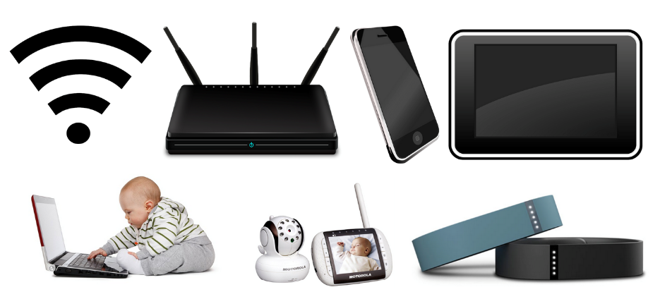
Challenges
Network Challenges
Scarce spectrum
Demanding/diverse applications
Reliability
Ubiquitous coverage
Seamless indoor/outdoor operation
Device Challenges
Size, Power, Cost
Multiple Antennas
Multi-radio Integration
Co-existence
Fading
CNSCC.405: Digital Signal Processing

Slide 6
Grand Challenges in Wireless Communications
Security, secrecy, and privacy
Resource and spectrum utilizations
Communication infrastructure
Energy efficiency enhancement
Integration of wireless information and power transfer
Wireless access techniques
Dynamic architecture and network functions analysis
Coding and modulation
Resource and interference management
https://www.frontiersin.org/articles/10.3389/frcmn.2020.00001/full
CNSCC.405: Digital Signal Processing

Slide 7
Elements of wireless Communication
Channel code word
Message Signal
Source
Encoder
Channel
Encoder
Modulator
Modulated
Transmitted Signal
Source
Wireless Channel
User
Source
Decoder
Channel
Decoder
Demod-
ulator
Received
Signal
Estimate of
Message signal
Estimate of
channel code word
CNSCC.405: Digital Signal Processing

Slide 8
Frequency Carries/Channels
The information from sender to receiver is carrier over a well-defined frequency band.
This is called a channel
Each channel has a fixed frequency bandwidth (in KHz) and Capacity (bit-rate)
Different frequency bands (channels) can be used to transmit information in parallel and independently.
CNSCC.405: Digital Signal Processing

Slide 9
Wireless Channel
The mobile radio channels places fundamental limitations on the performance of wireless communication systems
The wireless transmission path may be
Line of sight
Non line of sight: obstructed by buildings, mountains, foliage etc.
Characteristics of the channel appear to change randomly with time, which makes it difficult to design reliable systems with guaranteed performance.
Modeling the radio channel have been one of the difficult parts of the mobile radio system design.
CNSCC.405: Digital Signal Processing

Slide 10
Wireless Channel Impairments
Noise : Thermal noise (AWGN)
Path loss : The loss in power as the radio signal propagates.
Shadowing : Due to the presence of fixed obstacles in the radio path.
Fading : Combines the effect of multiple propagation path, rapid movement of mobile units and reflectors.
CNSCC.405: Digital Signal Processing

Slide 11
Link budget
Link budget is an important tool in the design of radio communication systems.
Accounting for all the gains and losses through the wireless channel to the receiver, it allows for predicting the received signal strength along with the required power margin.
Path loss and fading are the two most important factors to consider in link budget.
CNSCC.405: Digital Signal Processing

Slide 12
Link budget
The mean path loss is a deterministic factor that can be predicted with the distance between the transmitter and receiver.
Shadowing and small-scale fading are random phenomena, which means that their effects can only be predicted by their probabilistic distribution. For example, shadowing is typically modeled by a log-normal distribution.
CNSCC.405: Digital Signal Processing

Slide 13
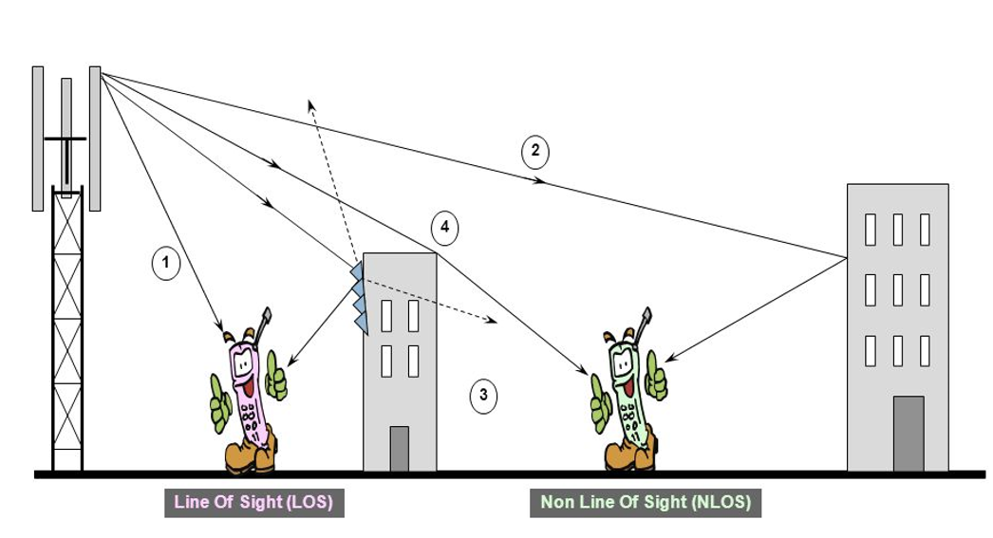
Radio Wave Propagation
CNSCC.405: Digital Signal Processing

Slide 14
Radio Propagation Mechanisms
Reflection occurs when the electromagnetic wave impinges on an object which has very large dimensions as compared to the wavelength e.g., surface of the earth, buildings wall etc.
Diffraction occurs when the radio path between the transmitter and receiver is obstructed by a surface that has sharp irregularities (edges)
Scattering occurs when the medium has objects that are smaller or comparable to the wavelength (smaller objects, rough surfaces or other irregularities on the channel)
CNSCC.405: Digital Signal Processing

Slide 15
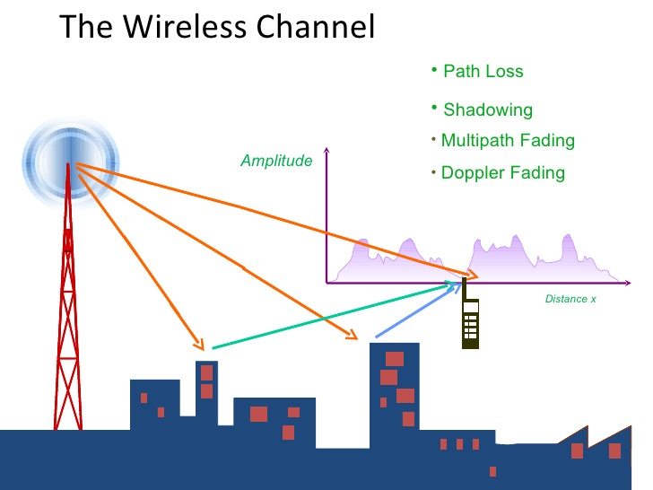
What is Fading ?
Fading is a deviation or attenuation a signal experiences over a certain propagation media.
In wireless communication, fading may be due to multipath propagation or due to shadowing from obstacles.
CNSCC.405: Digital Signal Processing

Slide 16
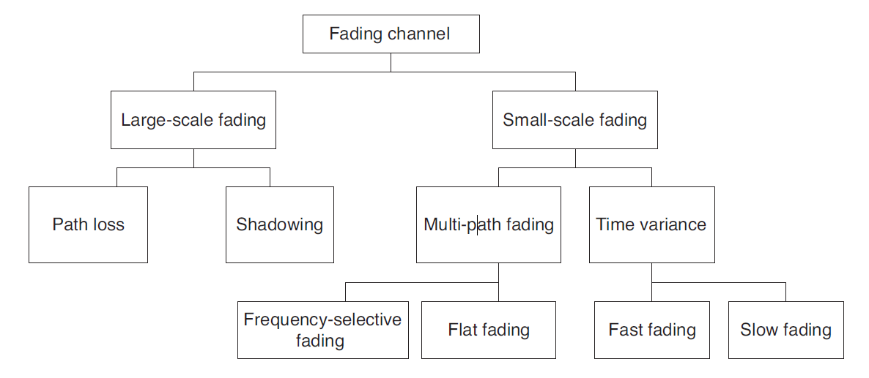
Classification of Fading Channels
CNSCC.405: Digital Signal Processing

Slide 17
Large-scale fading vs. small-scale fading
CNSCC.405: Digital Signal Processing

Slide 18
Large-Scale Fading
General Path Loss Model
CNSCC.405: Digital Signal Processing

Slide 19
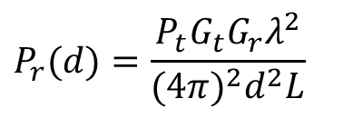
Free Space Propagation Model
The free space propagation model is used to predict received signal strength when the transmitter and receiver have a clear line-of-sight path between them.
satellite communication
microwave line-of-sight radio link
Friis free space equation
: transmitted power : T-R separation distance (m)
: received power : system loss
: transmitter antenna gain : wavelength in meters
: receiver antenna gain
$$P_{r}(d)=\frac{P_{t}G_{t}G_{r}λ^{2}}{(4π)^{2}d^{2}L}$$
CNSCC.405: Digital Signal Processing

Slide 20
The gain of the antenna
: effective aperture is related to the physical size of the antenna
The wavelength is related to the carrier frequency by
: carrier frequency in Hertz
: carrier frequency in radians
: speed of light (meters/s)
The losses are usually due to transmission line attenuation, filter losses, and antenna losses in the communication system. A value of L=1 indicates no loss in the system hardware.
CNSCC.405: Digital Signal Processing

Slide 21
Isotropic radiator is an ideal antenna which radiates power with unit gain.
Effective isotropic radiated power (EIRP) is defined as
and represents the maximum radiated power available from transmitter in the direction of maximum antenna gain as compared to an isotropic radiator.
Path loss for the free space model with antenna gains
When antenna gains are excluded
The Friis free space model is only a valid predictor for for values of d which is in the far-field (Fraunhofer region) of the transmission antenna.
CNSCC.405: Digital Signal Processing

Slide 22
The far-field region of a transmitting antenna is defined as the region beyond the far-field distance
where D is the largest physical linear dimension of the antenna.
To be in the far-filed region the following equations must be satisfied and
Furthermore, the following equation does not hold for d=0.
Use close-in distance and a known received power at that point
or
CNSCC.405: Digital Signal Processing

Slide 23
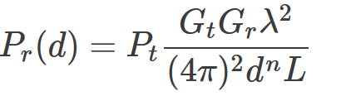
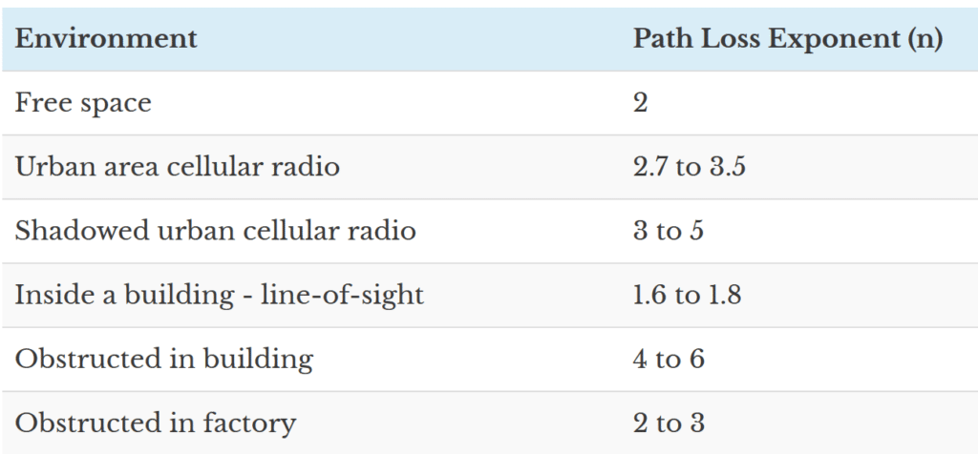

The Friis equation can be modified to accommodate different environments, on the reason that the received signal decreases as the n^{th} power of distance, where the parameter n is the path-loss exponent (PLE) that takes constant values depending on the environment that is modeled (see Table below} for various empirical values for PLE).
CNSCC.405: Digital Signal Processing

Slide 24
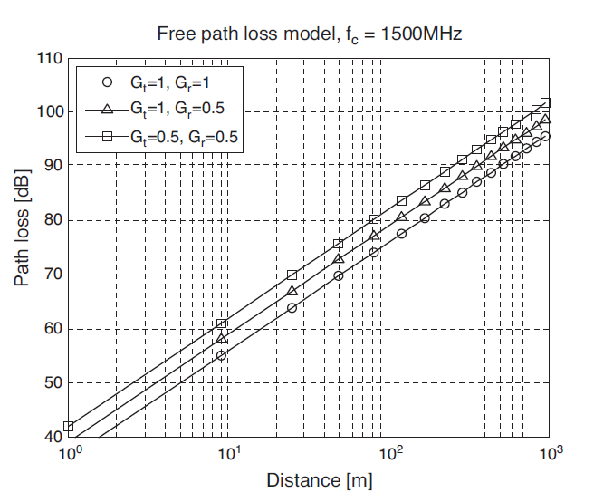
Free-space Path Loss Model.
free-space path loss at the carrier frequency of fc = 1.5 GHz for different antenna gains as the distance varies.
CNSCC.405: Digital Signal Processing

Slide 25

Examples
16.99 dBw, 46.99 dBm
1. Suppose a transmitter produces 50W of power. a. Express the transmit power in units of dBm and dBW.
b. If the transmitter’s power is applied to a unity gain antenna with a 900-MHz carrier frequency, what is the received power in dBm at a free space distance of 100 m?
c. Repeat (ii) for a distance of 10km.
d. Repeat (ii) (iii) under ground reflected model with the height of the transmitter and receiver being 30m and 1m respectively.
P_{r} = -24.62dBm
P_{r} = -64.52dBm
$$P_{r}(d)=\frac{P_{t}G_{t}G_{r}h_{t}^{2}h_{r}^{2} }{d^{2}}$$
P_{r} = -33.47 dBw, -113.47 dBw
2. Consider an indoor wireless LAN with fc = 900 MHz, cells of radius 100 m, and nondirectional antennas. Under the free-space path loss model, what transmit power is required at the access point in order for all terminals within the cell to receive a minimum power of 10µW? How does this change if the system frequency is 5 GHz?
Pt = 1.45 W = 1.61 dBW
P_{t} = 43.9 kW = 16.42 dBW
CNSCC.405: Digital Signal Processing

Slide 26
Methods used to overcome Fading
Diversity
CNSCC.405: Digital Signal Processing

Slide 27
Diversity
Diversity is a powerful communication technique that provides wireless link improvements at relatively low cost.
It provides two or more inputs at the receiver such that fading phenomenon among these inputs are uncorrelated.
If one radio path undergoes deep fading another independent path may have a strong signal at that input.
Diversity exploits the random nature of radio propagation by finding independent signal path for communication.
These independent paths are highly uncorrelated.
CNSCC.405: Digital Signal Processing

Slide 28
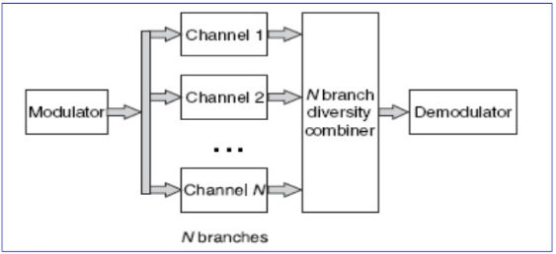
Need of Diversity
Diversity scheme is needed in wireless communication because if one path of radio signal undergoes a deep fading then another independent path may have a strong signal.
CNSCC.405: Digital Signal Processing

Slide 29
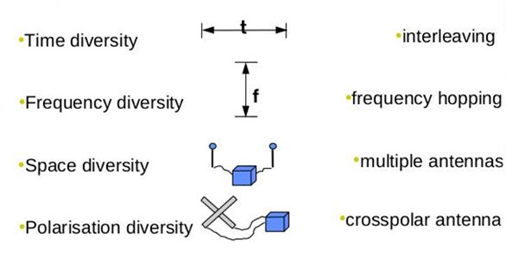
Diversity Techniques
Following are the different diversity techniques:
CNSCC.405: Digital Signal Processing

Slide 30
Space diversity
In space diversity, signal is propagated over various propagation paths.
It uses two or more antennas to receive the signal.
Antennas are spaced enough from each other.
In urban areas, there is no clear line-of-sight between the receiver and the transmitter, so signal is reflected along multipath. So, space diversity is used to overcome this.
It is also known as Antenna diversity.
In wired transmission, it is done by transmitting using multiple wires.
CNSCC.405: Digital Signal Processing

Slide 31
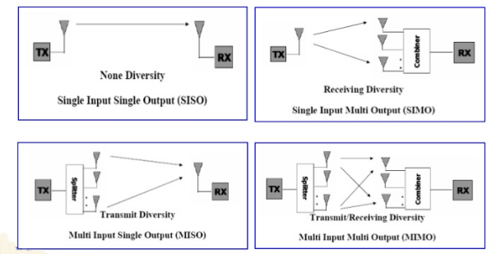
Space diversity
CNSCC.405: Digital Signal Processing

Slide 32
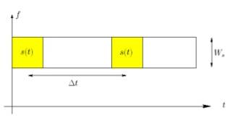
Time diversity
In this form, multiple version of same signal are transmitted at different time instant.
Same signal is transmitted various time.
Message is spread in different time intervals which avoids the error burst.
It repeatedly transmits information at time spacing that exceed the coherence time of channel.
The interval between the transmission of same data should be at least the coherence time.
Multiple repetitions of the signal will be received with independent fading conditions.
Interleaving is used to obtain time diversity in digital communication.
CNSCC.405: Digital Signal Processing

Slide 33
What is Interleaving ?
Interleaving is a way to arrange the data in non-contiguous way to increase the performance.
The function of inter-leaver is to spread the bits out in time so that if there is a deep fade or error burst, the important bits from the block of source data are not corrupted at the same time.
CNSCC.405: Digital Signal Processing

Slide 34
Frequency diversity
Frequency diversity is implemented by transmitted same information on more than one carrier frequency.
These carrier frequencies are uncorrelated to each other, so they don’t experience the same fading.
To make them least correlated, these carrier frequencies are separated by more than the coherence bandwidth of the channel.
CNSCC.405: Digital Signal Processing

Slide 35
Frequency diversity
Frequency Hopping Spread Spectrum (FHSS) is a special case of frequency diversity.
OFDM modulation and access technique exploit the frequency diversity.
This can be achieved by providing simultaneous modulation signals with error control coding across a large bandwidth.
If a particular frequency undergoes a fade, the composite signal will still be demodulated.
CNSCC.405: Digital Signal Processing

Slide 36
Polarization diversity
Multiple versions of a signal are transmitted and received using antennas with different polarization.
Antennas can be either horizontal or Vertically polarized.
The antennas take advantage of multipath propagation characteristics to receive separate uncorrelated signals.
SNR is improved by up to 12 dB even in line-of-sight channel.
CNSCC.405: Digital Signal Processing

